Slide 1
Socioeconomics and Cancer Mortality Rates in US Counties

Slide 2

Introduction
Cancer is a group of diseases characterized by uncontrolled growth and spread of abnormal cells in a specific region, and it can have a fatal impact on the body as a whole

Slide 3


In 2015, a total of 1,633,390 new cancer cases were reported in the United States: 816,937 in men and 816,453 in women. The overall incidence rate was 437.7 per 100,000 persons
Our study aims to examine the effect of socioeconomic factors on the incidence and mortality rates of cancer

Slide 4
OUR DATASET
We choose a dataset that focus on several socioeconomic attributes that are hypothesized to affect the incidence and mortality rates of cancer in each country

Slide 5
Methods
Exploring the dataset
Handling the outliers
Data Cleaning

Slide 6
Methods
Exploring the dataset
Data Cleaning
Handling the outliers

Slide 7
Methods
Correlation Coefficient
Linear Regression
Standardization

Slide 8
Methods
Correlation Coefficient
Standardization
Linear Regression

Slide 9
Methods
Multivariable Regression
Hypothesis Testing
Assessing the multivariable regression

Slide 10
Methods
Multivariable Regression
Hypothesis Testing
Assessing the multivariable regression

Slide 11
Exploring the dataset
Exploring the data helped us to identify the nature of attributes in a dataset. The exploration revealed that there are only two categorical variables, which are the city and district from which the data was collected.

Slide 12
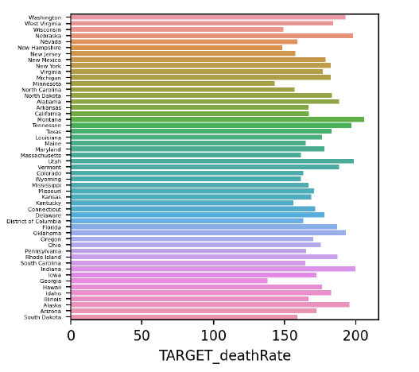
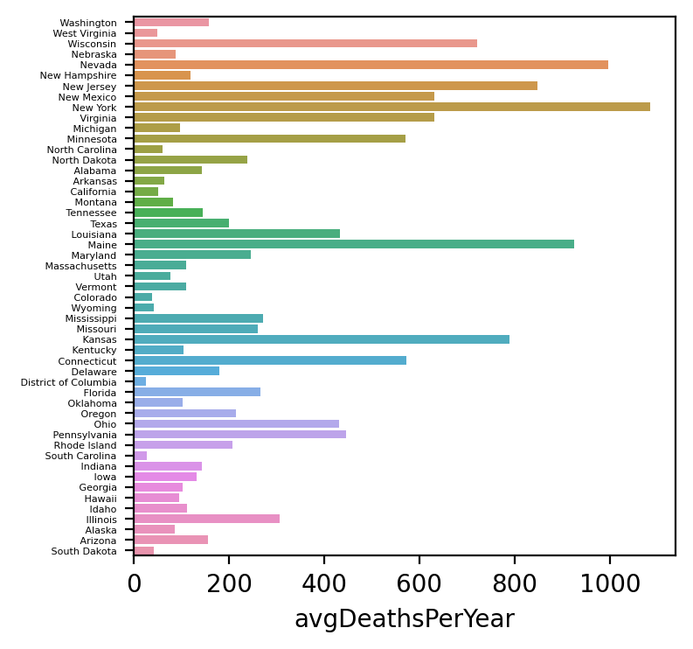
We notice from the two following figures that in most counties, the actual death rate is way lower than the predicted one, except for a few counties such as Kansas and New Jersey, New York, Louisiana, Connecticut, Maine, etc.

Slide 13
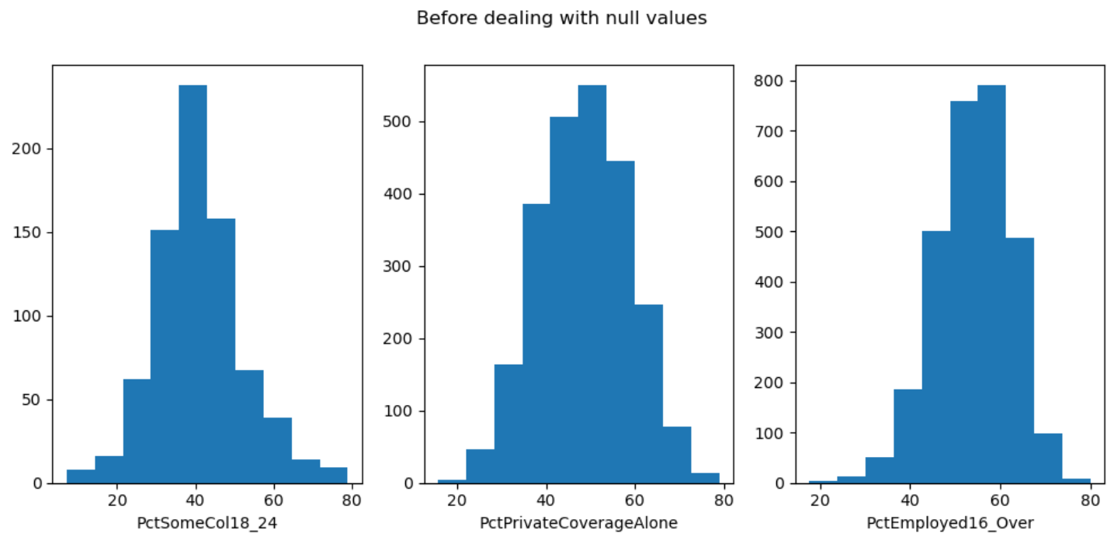
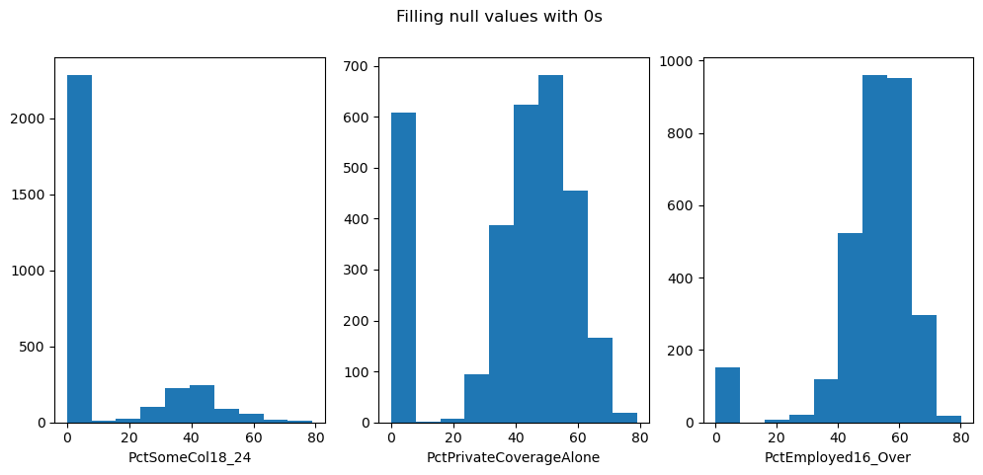
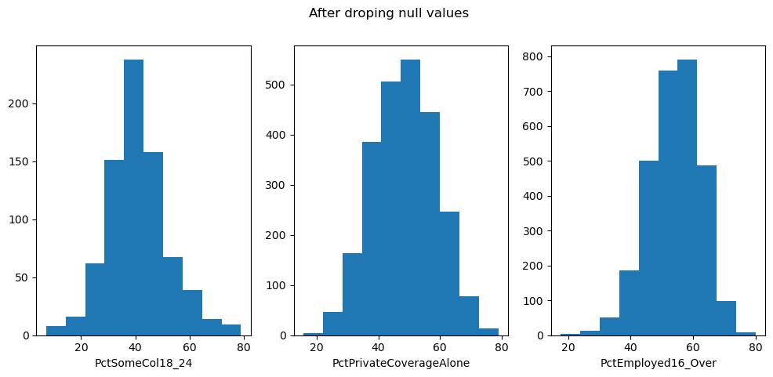
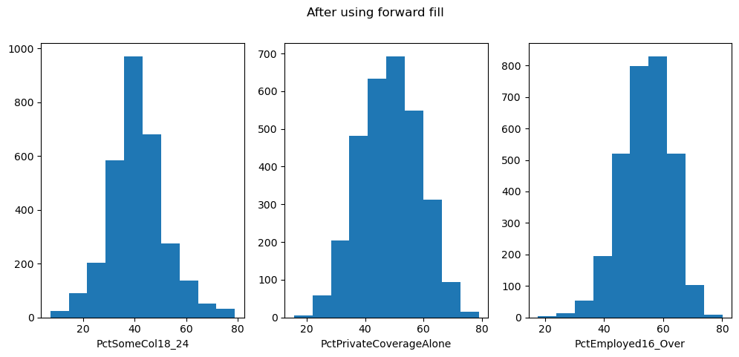
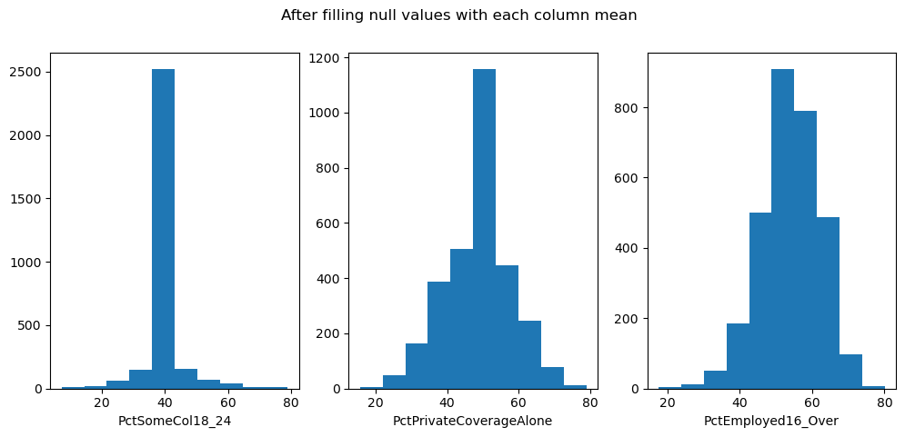

Data Cleaning
The three attributes with null values
Filling null values with zeroes
After dropping null values
After using the forward fill method
After filling values with each column mean

Slide 14
Handling the outliers:
There are two common methods for removing outliers: interquartile range and Z-score. we chose to use the interquartile range method because most of our data are not normally distributed. The interquartile range method involves dividing the data into four equal parts, finding the first and third quartiles, and subtracting the first quartile from the third quartile to obtain the interquartile range value.

Slide 15
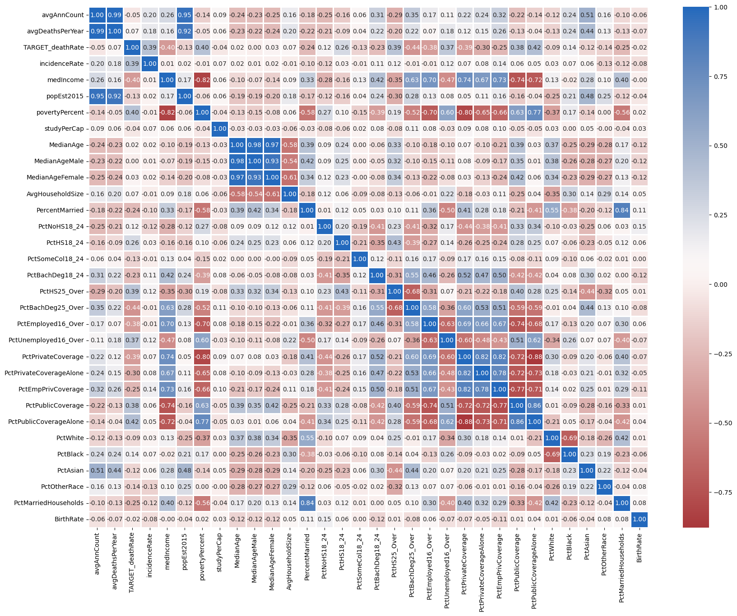
Pearson Correlation Coefficient
After we had successfully removed the outliers, we went on to choose the attributes that were believed to strongly affect the data by calculating the correlation coefficient ( r )
From above heat map we selected the attributes that have a high correlation.
So we chose a range of [−1: − 0.3] ∪ [0.3: 1]

Slide 16

Standardization
Before we perform the linear regression model, we must ensure that all the newly selected attributes are on a similar scale to prevent attributes with large scales from dominating the analysis. And that is called data standardization or Z-score normalization.

Slide 17
Hypothesis Testing
Assuming the null hypothesis 𝐻0 is the distribution of each feature is normal. Consequently, the alternative hypothesis 𝐻𝑎 is the distribution is not normal. And to check this, we followed the Shapiro-Wilk test:
We measure the discrepancy between the observed data and the expected data under the assumption of normality. we calculate the p-value, which represents the strength of the evidence against the null hypothesis. So if the p-value is less than or equal to the significance level "Alpha", this would mean that the alternative hypothesis is true and the feature’s distribution is not normal. And if the p-value is greater than the significance level, it would mean that the null hypothesis is true and the feature’s distribution is normal.

Slide 18


Linear Regression
We start by calculating linear regression by calculating the mean
of each feature and its target provided in the dataset.
we calculate the standardized covariance and the variance of the feature. That is done to find the 6 coefficient and be able to calculate and predict the slope and intercept.

Slide 19



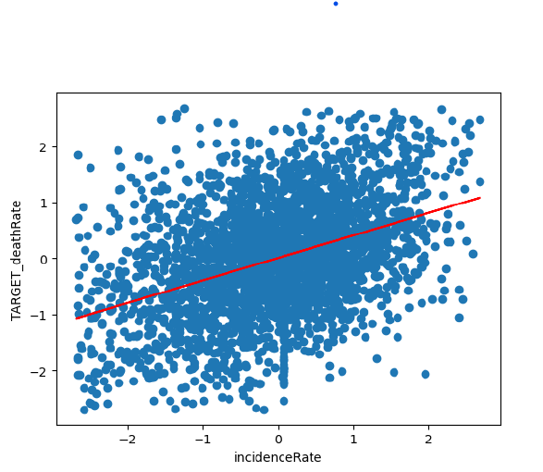
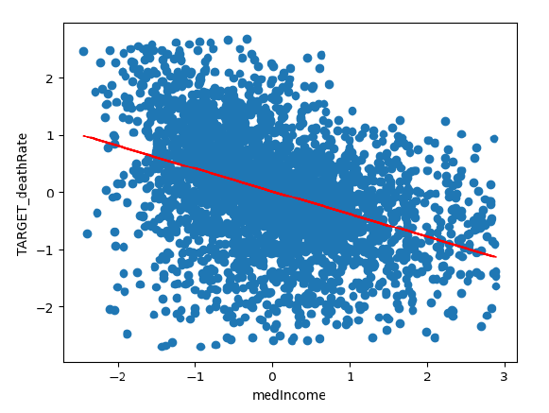
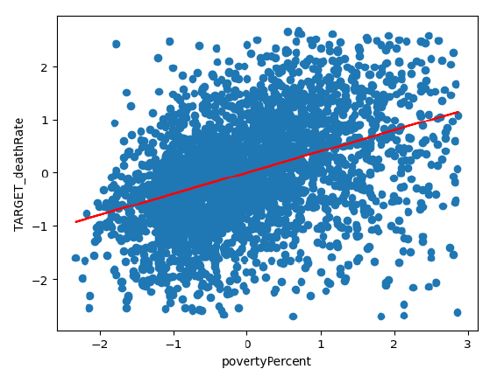
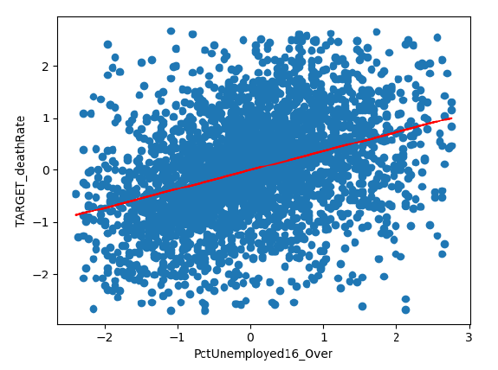
(b1) The slope can be calculated from the following Equation :
(b0) can be calculated from the following Equation :
The best-fit line is found by the following formula:
Some visualizations of Linear Regression

Slide 20
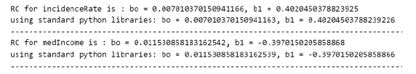
After we calculated the model from scratch, we can start using the available functions in the Scikit-learn python package and compare the two results to determine the accuracy of our model.
Multivariable Regression : In this step, the Scikit-learn package is used to make a multivariable regression model between the target death rate and all other features.

Slide 21

Assessing the multivariable regression quality :
The goal of this process is to evaluate the performance of the model and determine how well it fits the data.
Individual Regression Coefficients
Regression Model as a whole
$$\sqrt{\frac{\sum_{i=1}^{n}{{(x−\overline{x})}^{2}}}{n}}$$
R-squared:
tells us how much of the variation in the outcome
we can explain using the predictors we have in our model
If the R-squared value is higher (close to 1)
it means that our model fits the data better.
Adjusted R-squared:
This variant of R-squared adjusts for the number of predictors
in the model, penalizing the inclusion of unnecessary variables.
It is a more conservative measure
that accounts for model complexity.
RMSE Formula
Error in Attribute | Error in %
incidenceRate | 1.67
medIncome | 1.67
povertyPercent | 1.67
PctHS25_Over | 1.68
PctBachDeg25_Over | 1.65
PctEmployed16_Over | 1.68
PctUnemployed16_Over | 1.70
PctPrivateCoverage | 1.69
PctPrivateCoverageAlone | 1.74
PctPublicCoverage | 1.68
PctPublicCoverageAlone | 1.66
Error in the multivariable regression model 1.304%

Slide 22

Results
$$\hat{y}=0.007+\left(0.402\right)∗\left(incidence rate(x_{1})\right)$$
$$\hat{y}=0.016+\left(−0.397\right)∗\left(medIncome(x_{2})\right)$$
$$\hat{y}=−0.003+\left(0.4\right)∗\left(povertyPct(x_{3})\right)$$
$$\hat{y}=0.004+\left(0.391\right)∗\left(PctHS24(x_{4})\right)$$
$$\hat{y}=0.007+\left(0.433\right)∗\left(PctBachDeg25(x_{5})\right)$$
$$\hat{y}=0.001+\left( −0.393\right)∗\left(PctEmployed16_over(x_{6})\right)$$
$$\hat{y}=−0.002+\left(0.364\right)∗\left(PctUnemployed16_over(x_{7})\right)$$
$$\hat{y}=0.001+\left(−0.380\right)∗\left(PctPrivateCoverage(x_{8})\right)$$
$$\hat{y}=0.002+\left(−0.306\right)∗\left(PctPrivateCoverageAlone(x_{9})\right)$$
$$\hat{y}=0.002+\left(0.387\right)∗\left(PctPublicCoverage(x_{10})\right)$$
$$\hat{y}=−0.0001+\left(0.422\right)∗\left(PctPublicCoverageAlone(x_{11})\right)$$
$$model= 0.3717 ∗ x1 −0.0789 ∗ x2 + 0.093 ∗ x3 + 0.2291 ∗ x4 −0.0744 ∗ x5 −0.0443 ∗ x6 + 0.1036 ∗ x7 −0.1312∗ x8 + 0.0219 ∗ x9 −0.0991∗ x10 + 0.065 ∗ x11 + 0.0074$$

Slide 23
Conclusion
Increasing the median income of a county can reduce the cancer mortalities. Since the resident can access better or more healthcare services.
The higher the percent of people with higher education in a county, the less the cancer mortalities. As the educated individual can follow a lifestyle that protects him from having cancer such as avoiding tobacco or alcohol. Consequently, this will reduce the incidence rate

Slide 24
The type of the health coverage which a resident in a county receives has a significant impact on the cancer mortalities in a county. This health coverage can help the resident access better healthcare services.
The more unemployed people in a county, the more the probability of having high cancer mortalities. As an unemployed resident won’t have sufficient money to access several health services. Also, he could suffer from bad lifestyle such as low-quality nutrition that increases the cancer incidence rate such as colorectal cancer.

Slide 25
Thank You

